Slide 1
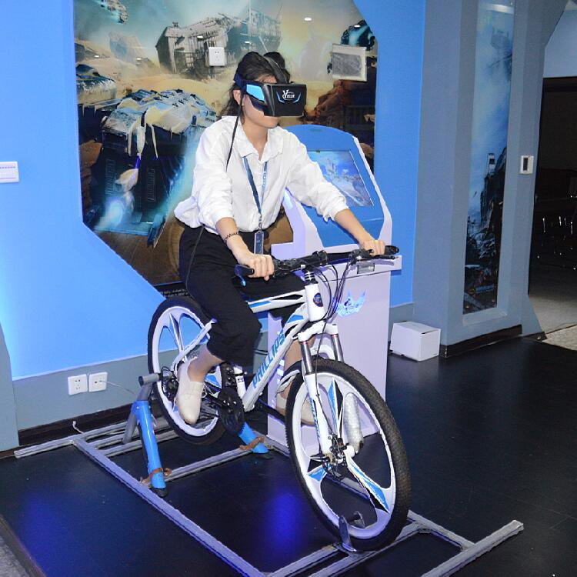
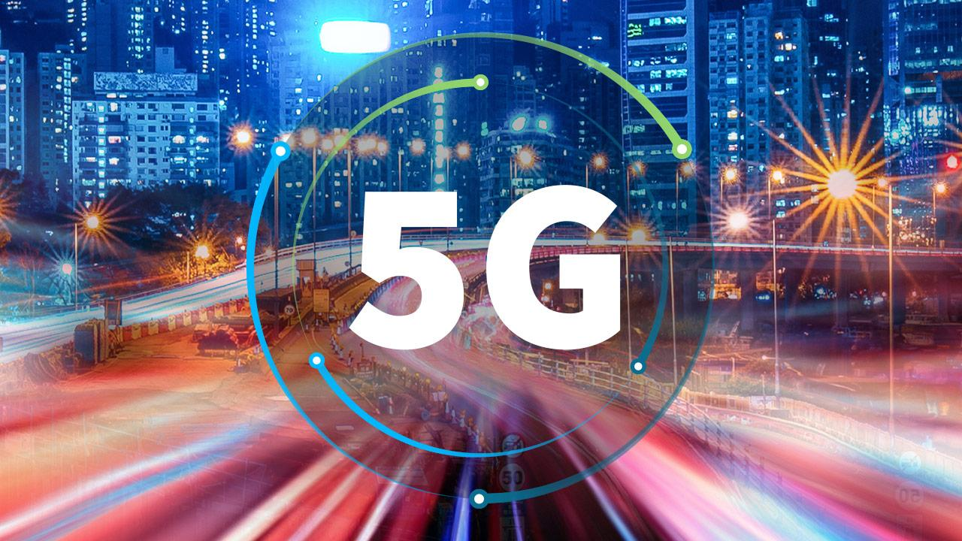
Competitive Virtual Cycling Over 5G
Group members:
180639P - T.A.D.S. Thennakoon
180236D - H.A.D.G. Hettiarachchi
180288L - D.S.B.C.L. Jayaweera
180316A - U.W.R.A.L. Karunathilaka
Supervisor – Prof. Dileeka Dias
Co-supervisor – Dr. Kasun Hemachandra

Slide 2
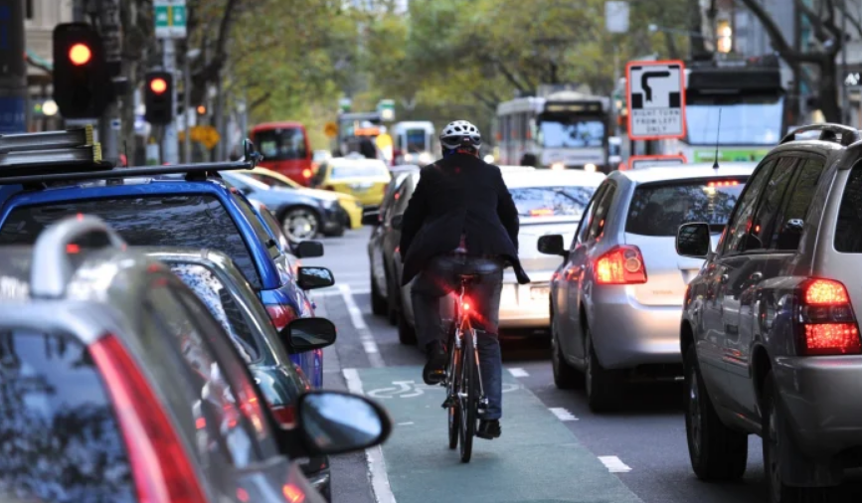
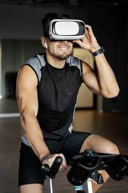
Background
Avoid problems of outdoor cycling
Safer and more comfortable environment
Virtual cycling experience in an immersive environment
Competitive cycling experience at different geographical locations

Slide 3
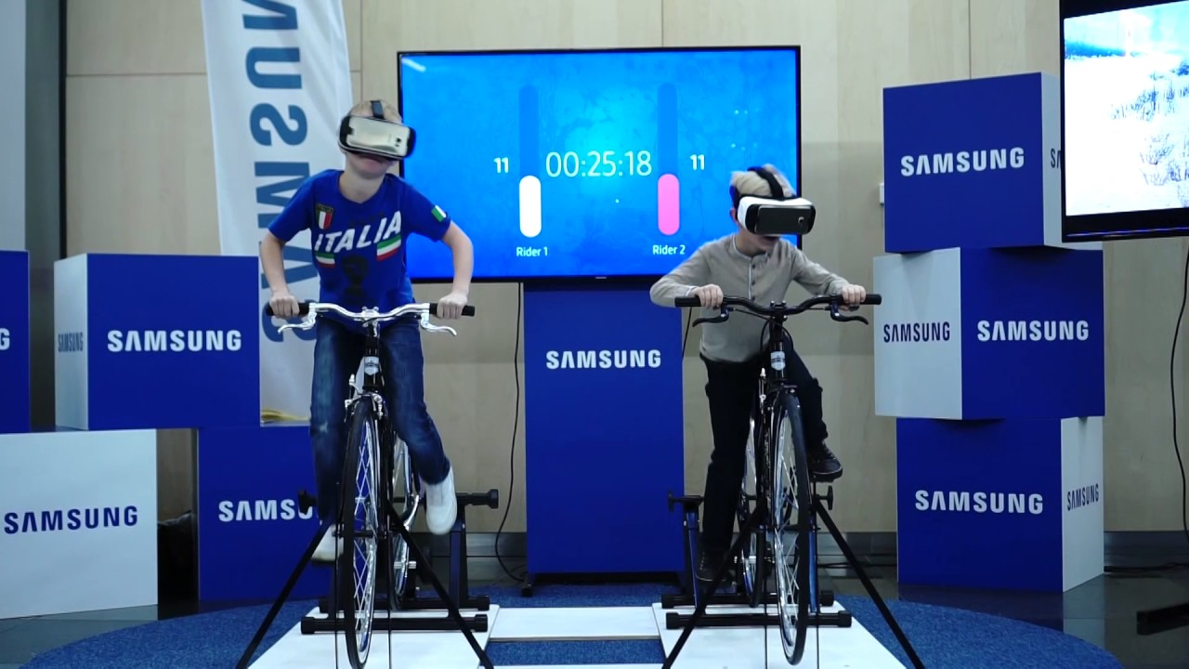
Project Scope
Streaming a 360-degree video to a head-mounted display using Unity Gaming Engine
5G technology is used to achieve low latency and high bandwidth requirements
Gives a competitive cycling experience for the cyclists
The relative position between competitors is calculated based on the outputs of the gyroscope
Web dashboard to show user’s competition statistics and health details

Slide 4
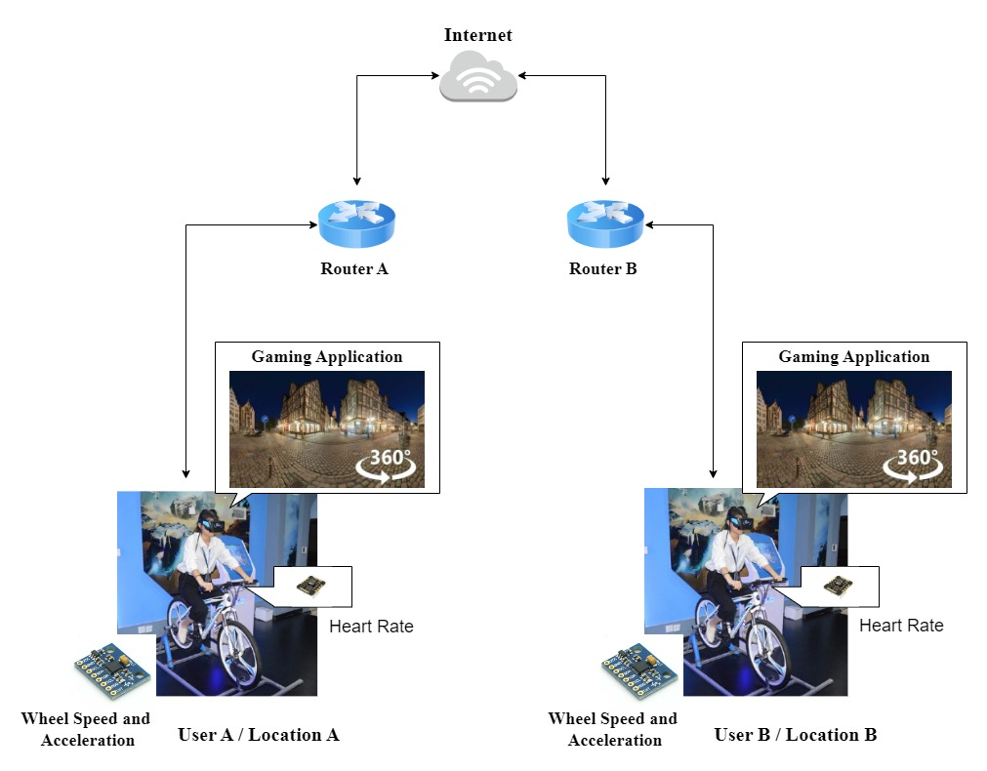
Project Overview

Slide 5
Technology Stack
Technology | Description | Useful Features
Head-mounted display(HMD) | Oculus Quest 1 device | Codeless HMD which uses 4 cameras for motion tracking
Nginx media server | Open-source software which can be used for web serving, load balancing, and media streaming | Streaming multiple instances of the video to multiple users.
Firebase web hosting service and database | Can be used to host the user dashboard and store the values of sensor outputs | Real time database
Unity gaming engine | Creating the gaming application which can be installed in the VR headset. | Easy to learn, Huge amount of free assets, and has an OVR controller component to give an immersive experience using Oculus.
ESP32 | Used to send the sensor data to other users. | Lightweight, low power consuming, has an onboard Wifi module.
Raspberry Pi 3B+ | Small size single board computer which is used to host the nginx media streaming server. | Has higher computational ability

Slide 6
Technology Stack
Technology | Description | Useful Features
HLS | HLS streaming protocol is used to streaming videos to the user from the server. | HLS allows client devices to seamlessly adapt to changing network conditions by raising or lowering the quality of the stream.
MQTT | Publish subscribe architecture protocol that is used to communicate data between two users. | This is a connection-oriented protocol. Also using acknowledgements, it ensures that all the packets are transmitted. Hence, it is more reliable.
UDP | Client- server architecture protocol that is used to communicate data between two users. | This is a connectionless protocol. Faster than connection-oriented protocols. Less packet overhead.
There can be two methods that users can engage with this platform.
Two users at different geographical locations, accessing the platform using different routers.
Two users at the same location accessing the platform using the same router.
Ex: Gyms and training centers

Slide 7
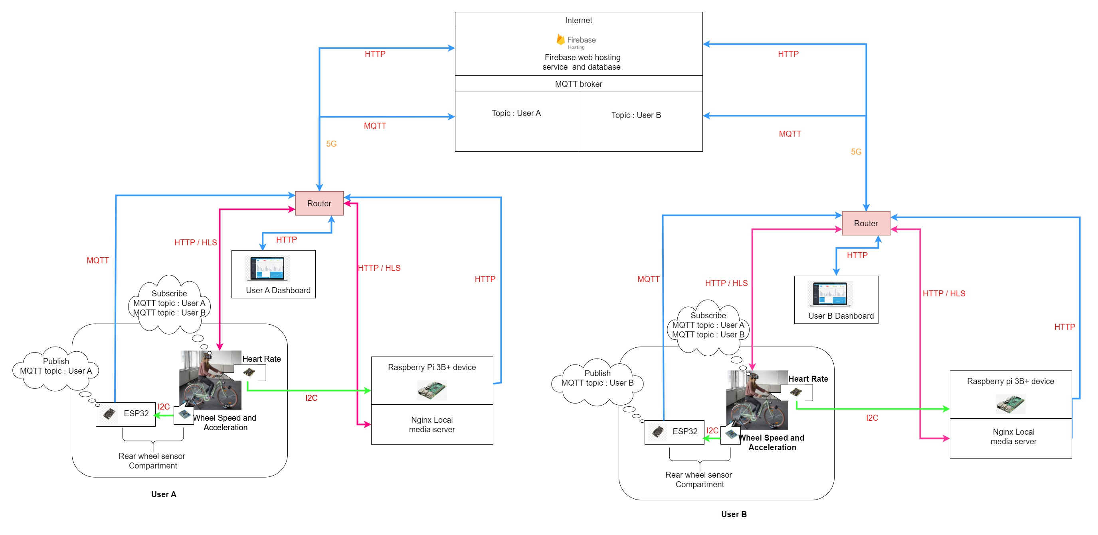
System Architecture 1 – 1st Scenario

Slide 8
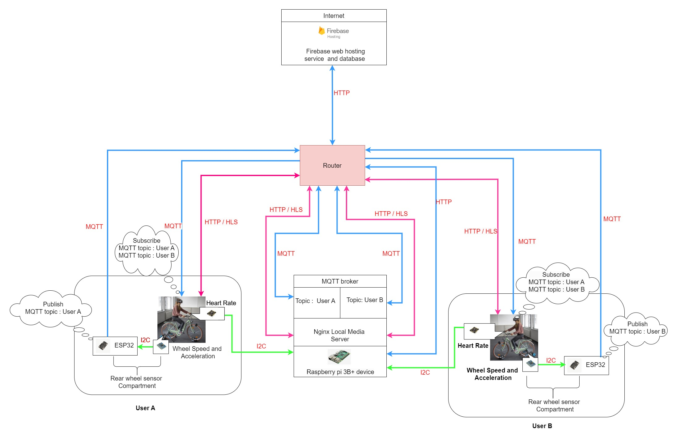
System Architecture 1 – 2nd Scenario

Slide 9
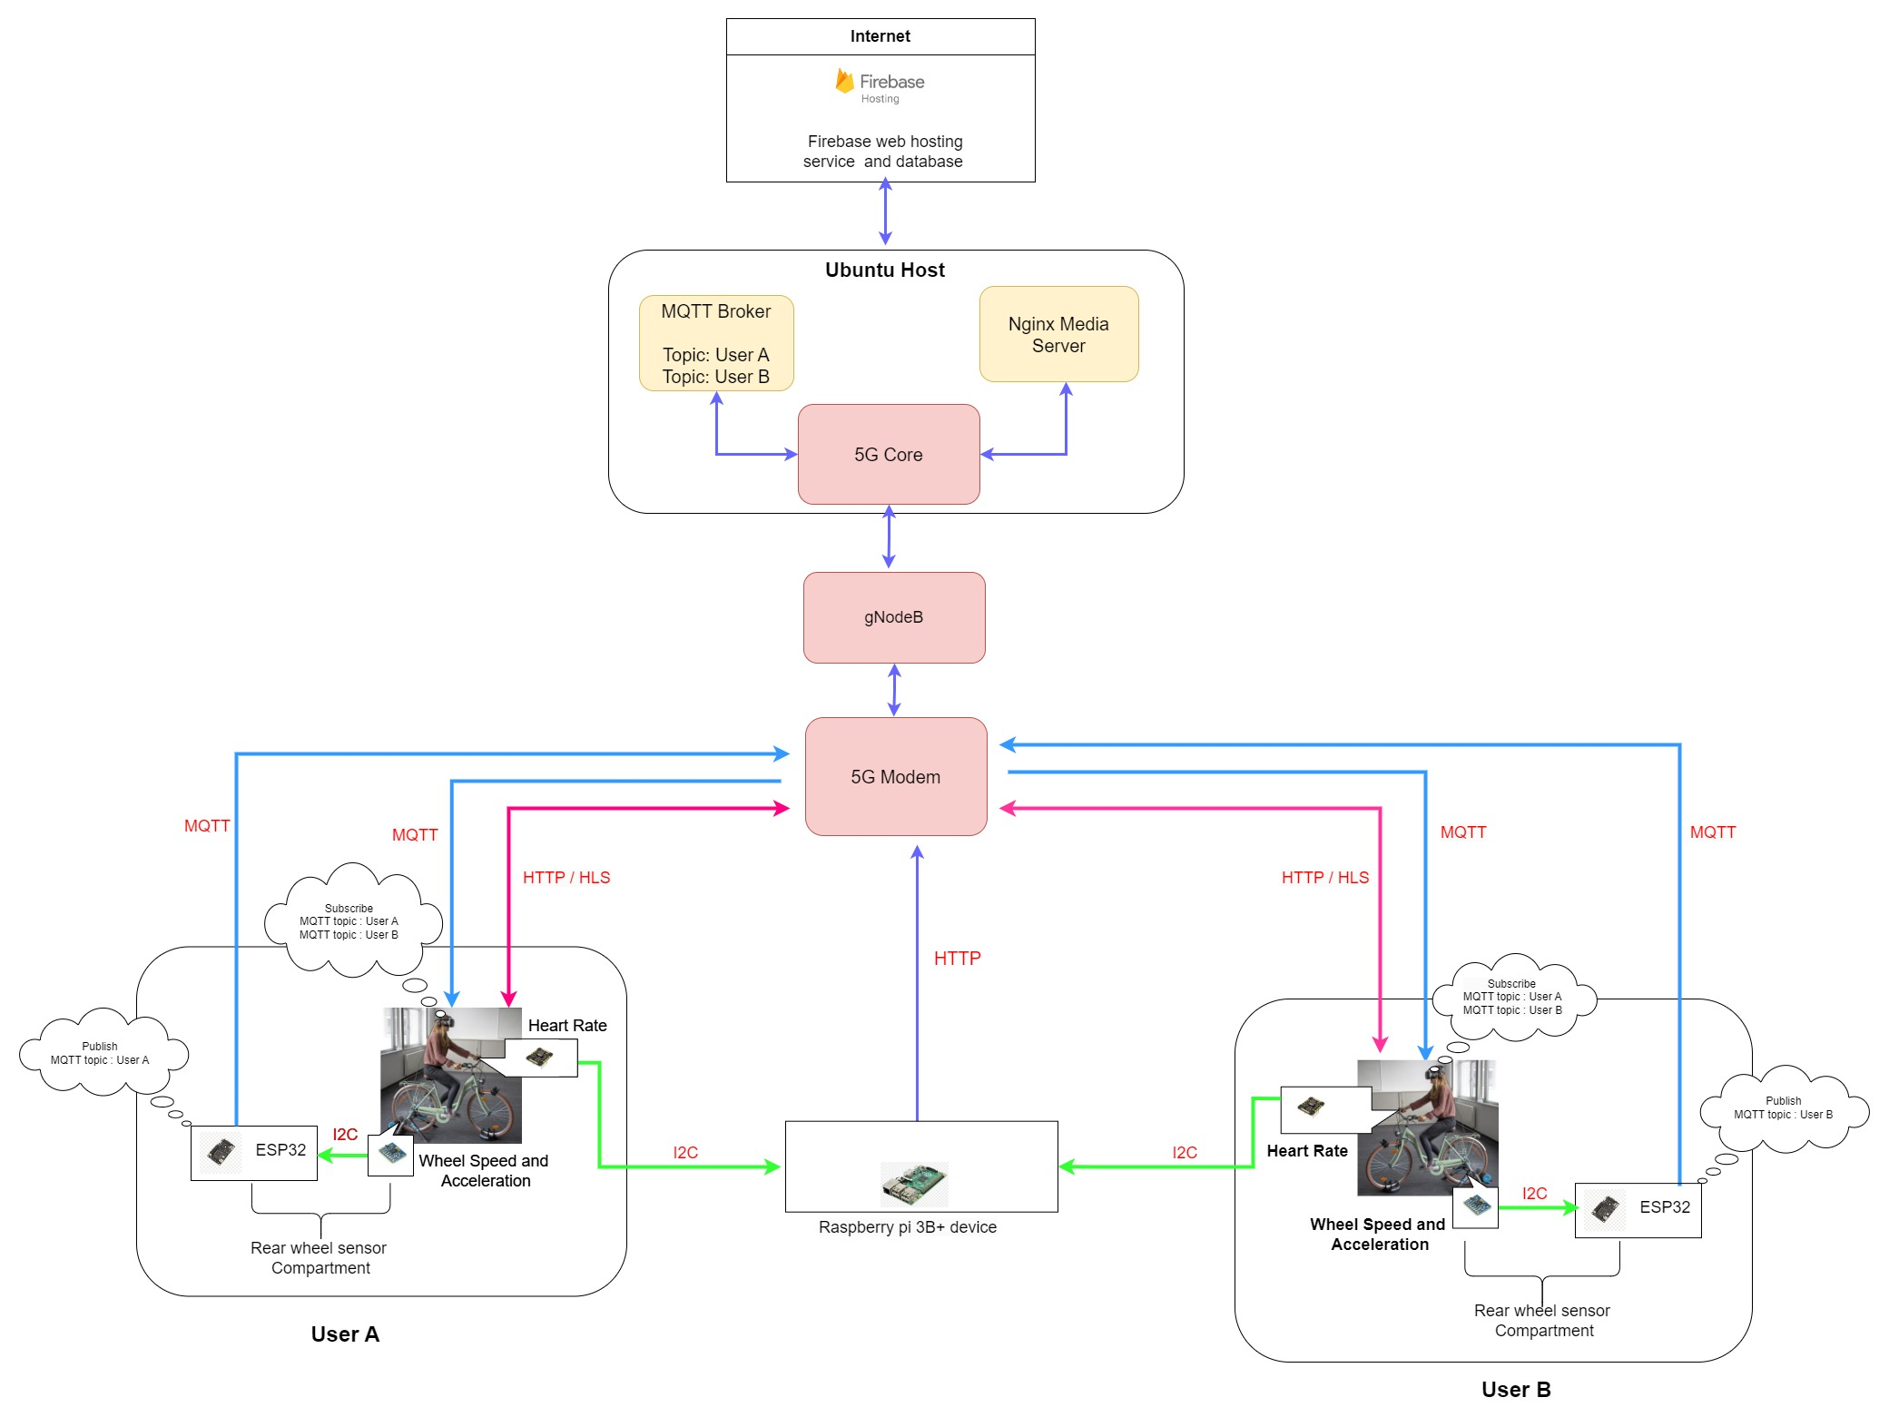
System Architecture 2

Slide 10
Current Progress
1. 5G network setup
Studied how we can achieve lower latency through 5G cellular technology.
Deployed the whole 5G network with default configurations with the help of some simulators.
Successfully streamed the video from the media server which is in the 5G core.
2. Performance evaluation
Experiments were done to measure the data (speed, distance) communication delay in two different scenarios. The first one is using the same local area network while the other is using two different local area networks.
MQTT, UDP protocols were used in the experiments which can be used in resource constraint devices.
3. Hardware designing
Designed the PCB of the sensor compartment using Altium.
Designed the enclosure of the sensor compartment using Solidworks.
4. Unity gaming application
Designed sample scenes for the user interfaces.
Added MQTT subscriber scene to take inputs and video scene to set the playback speed manually.
Successfully built an apk and tested it with Oculus device through Meta Quest developer hub.

Slide 11
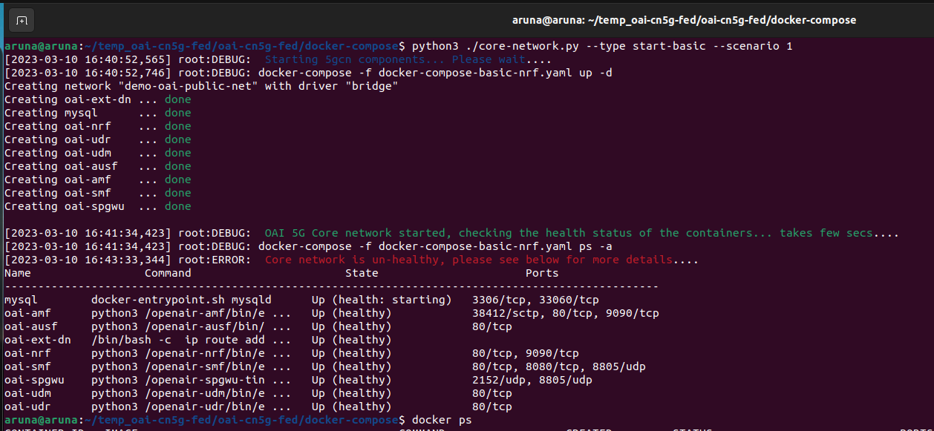
Deployment of the 5G Core

Slide 12
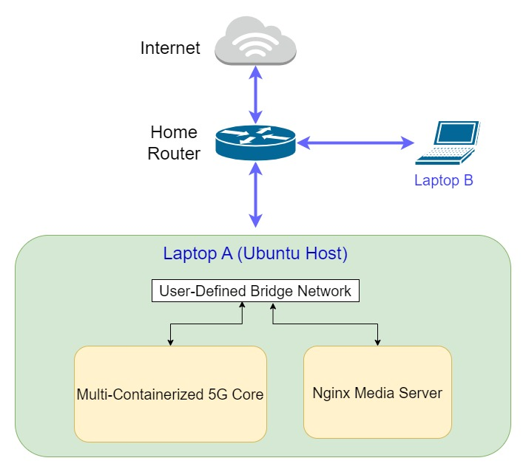
Streaming Setup

Slide 13
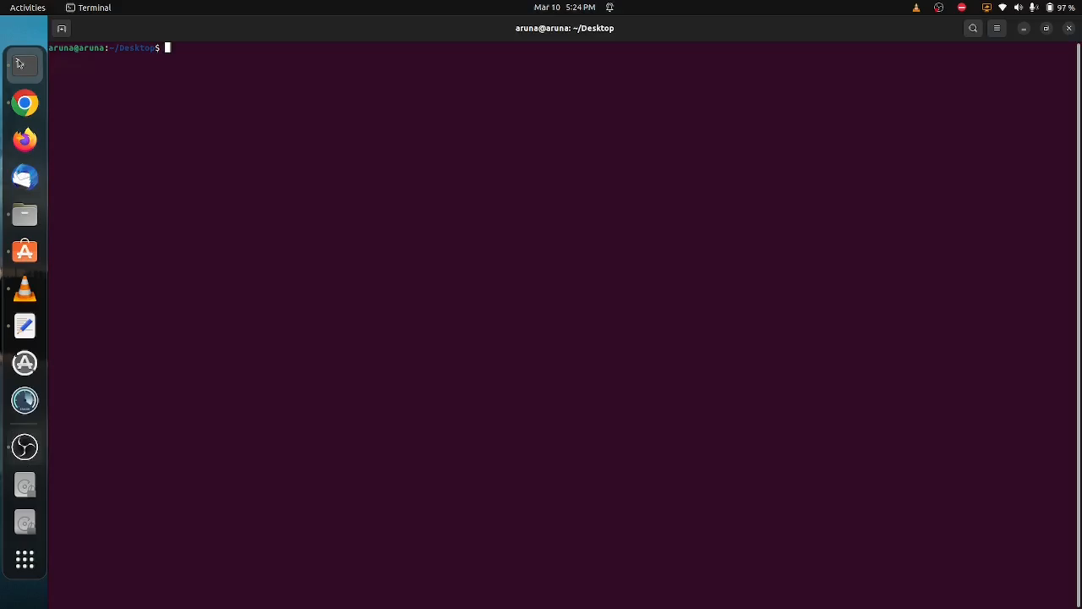
Streaming

Slide 14
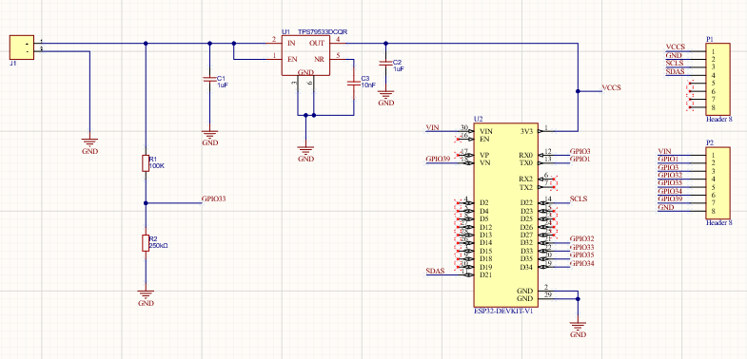
Rear wheel sensor compartment
Schematic
Single 3.7v li-ion battery is used as the power source in order to reduce the weight and the size of the sensor compartment.
A low dropout voltage regulator ensures the functionality of the device for a longer time.

Slide 15
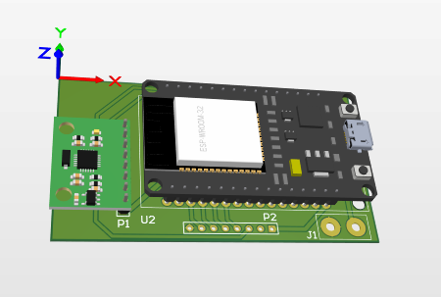
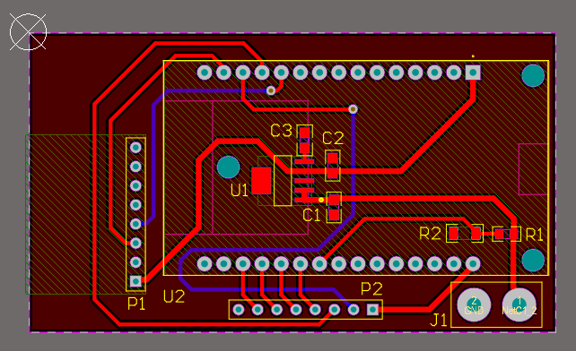
Rear wheel sensor compartment
PCB design
3D view

Slide 16
Performance Evaluation (Delay calculation )
Latency is the main critical concern that should be addressed.
Experiments were done to measure the data (speed, distance) communication delay .
MQTT, UDP protocols were used in the experiments which can be used in resource constraint devices.
Experiments were done for two different scenarios.
Two different users are in the same local area network.
Two different users are in two different local area networks.
Experiment | Used Protocol | Conducted / To be conducted
Two different users are in the same local area network. | MQTT | Conducted
 | UDP | To be conducted
Two different users are in two different local area networks. | MQTT | To be conducted
 | UDP | Conducted

Slide 17
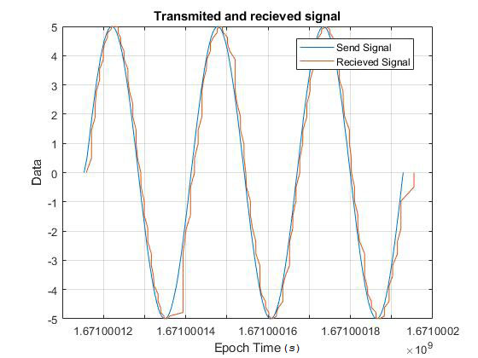
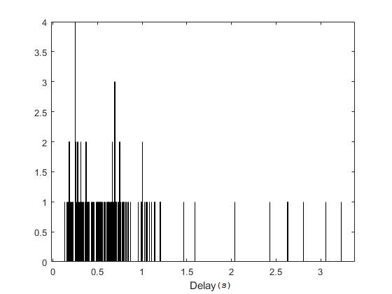
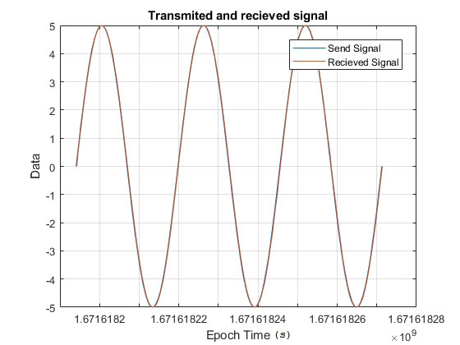
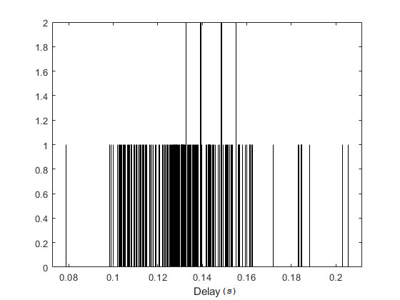
Two different users are in two different local area networks.
Used Protocols : MQTT
Service provider, Used network device and results | Sample experiment | Result representation
Service provider – Dialog Network Type - 4G Mean delay – 597.9 ms Standard deviation - 478 ms
Service provider – Dialog Network Type - 5G Mean delay – 131.9 ms Standard deviation - 20.2 ms

Slide 18
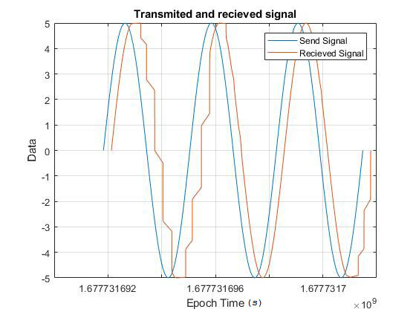
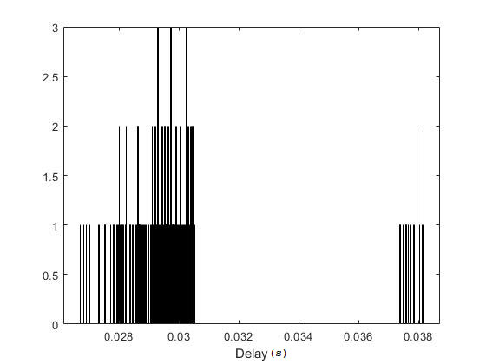
Two different users are in the same local area network.
Used Protocols : UDP
Service provider, Used network device and results | Sample experiment | Result representation
Mean delay – 30.0 ms Standard deviation - 2.5 ms

Slide 19
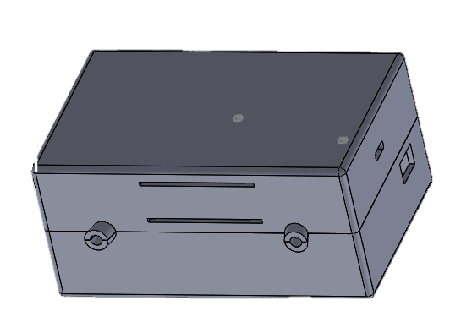
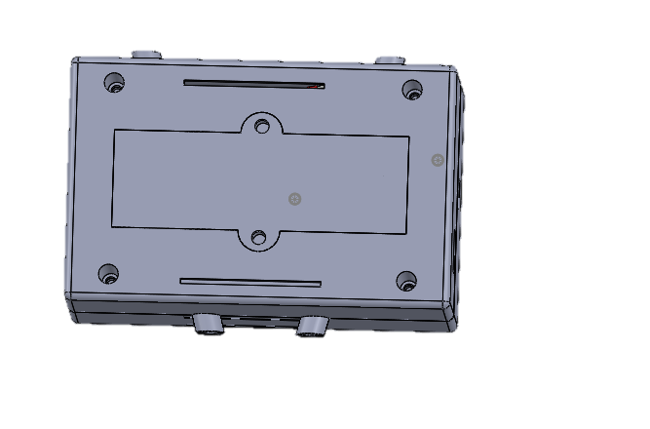
Enclosure Design
Main Components
Top Part
Bottom Part
Battery Holder
Slider
Length = 110mm Width = 70mm Height = 52mm

Slide 20
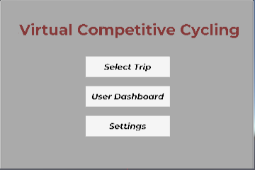
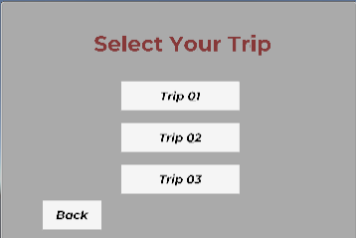
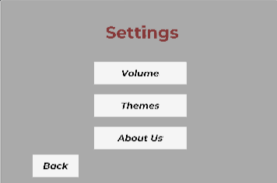
Unity Gaming Interface
Created main interfaces for gaming environments.
Added MQTT subscribing part and video streaming into the project.
Successfully built an apk and tested it on the Oculus device through Meta Quest Developer Hub.

Slide 21
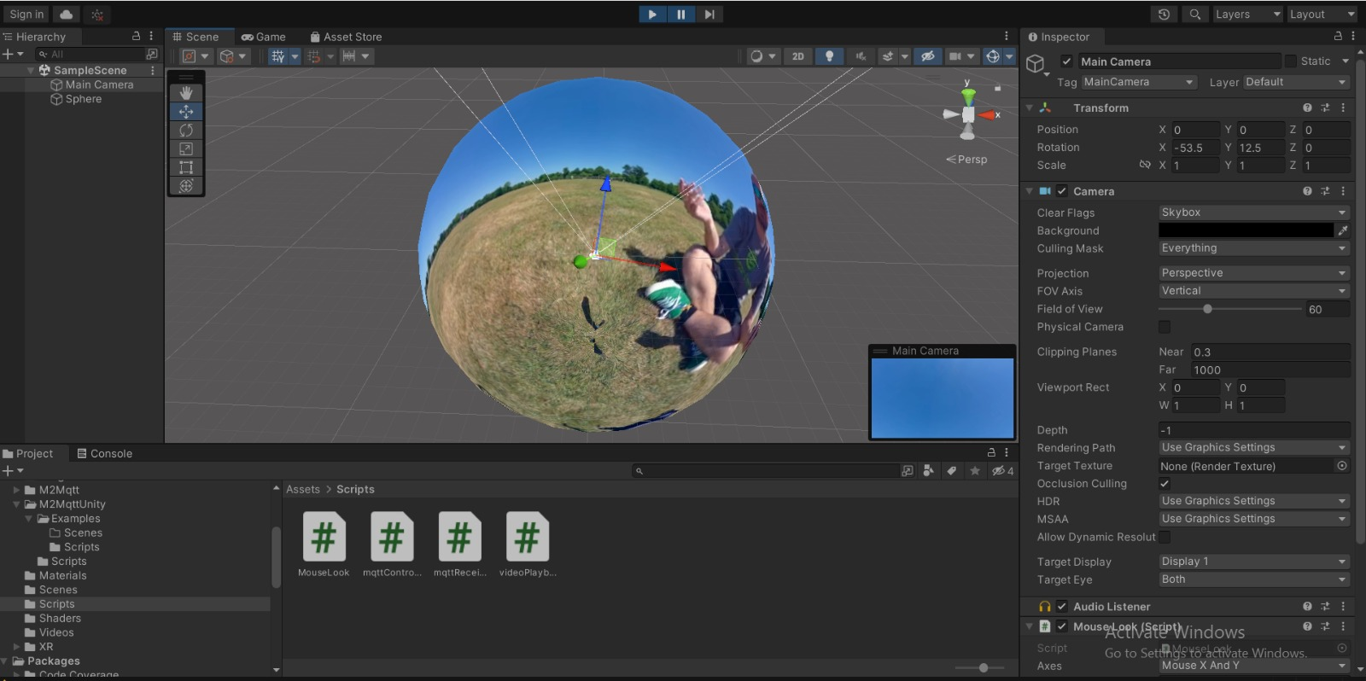
Unity Gaming Environment
Main Camera Component
MQTT Receiver Component
OVR Controller Component
Sphere Module Component
Streaming Video Receive Component

Slide 22
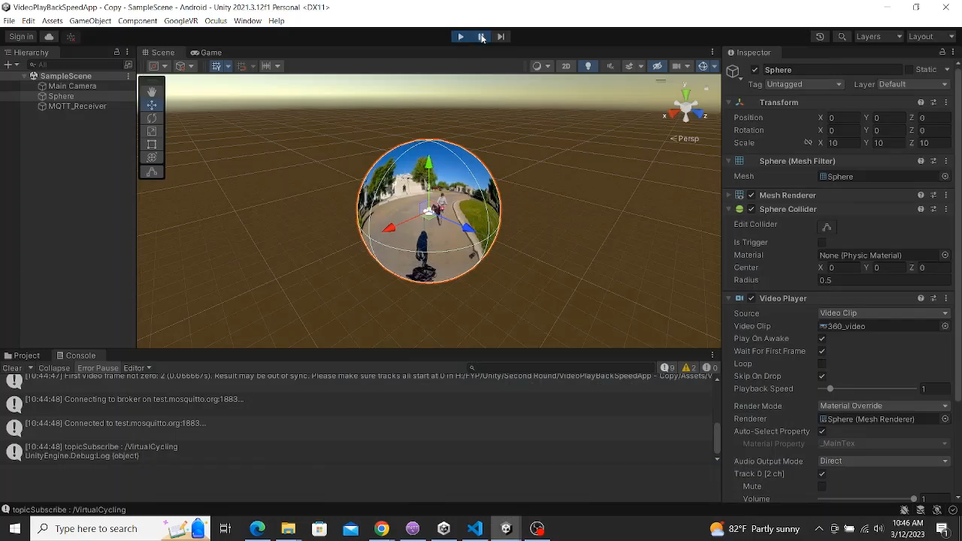

Slide 23
Challenges
1. Connectivity issues in the Software Defined Radio Setup.
2. Lack of resources such as oculus and routers with static IP addresses.
3. Getting the streamed video from the unity gaming engine and adjusting the playback speed.
We are working closely with Dialog innovation center to find necessary solutions for above challenges.

Slide 24
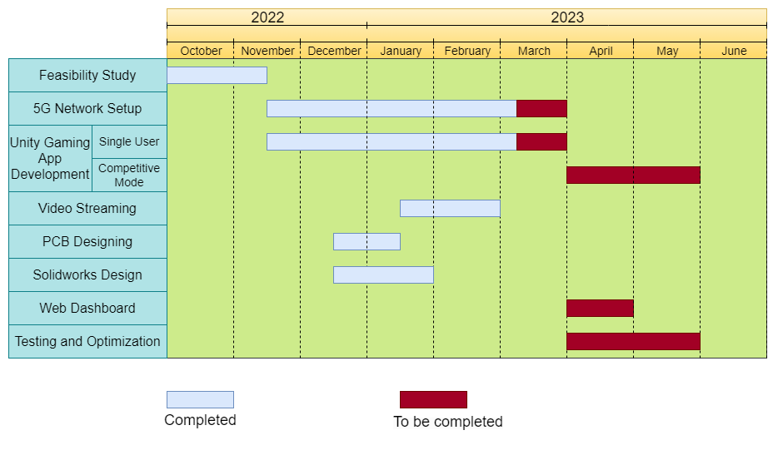
Progress

Slide 25
References
[1] https://gitlab.eurecom.fr/oai/cn5g/oai-cn5g-fed/-/blob/master/docs/DEPLOY_HOME.md
[2] Egils Ginters, Augmented reality use for cycling quality improvement, Procedia Computer Science, Volume 149, 2019, Pages 167-176, ISSN 1877-0509, https://doi.org/10.1016/j.procs.2019.01.120
[3] https://www.huawei.com/minisite/pdf/ilab/cloud_vr_network_solution_white_paper_en.pdf
[4] https://www.digitalocean.com/community/tutorials/how-to-set-up-a-video-streaming-server-using-nginx-rtmp-on-ubuntu-20-04

Slide 26
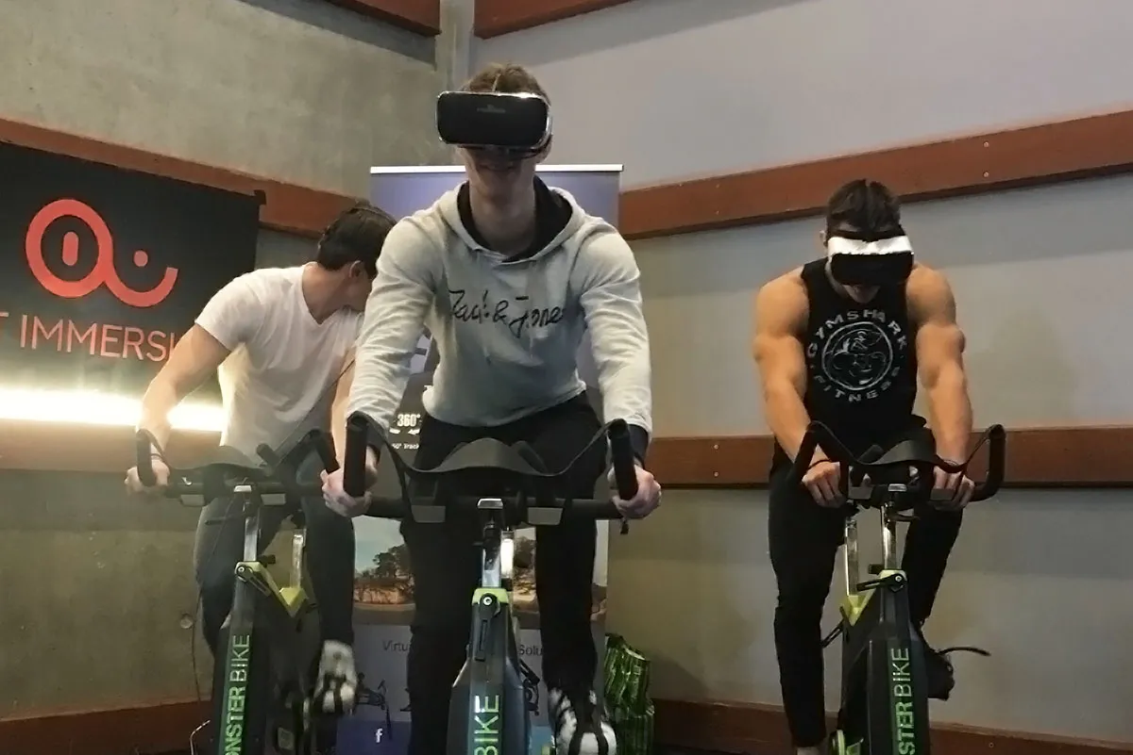
Thank You

